Slide 1
Side-Channel Attack
Simple Power Analysis on RSA Algorithm
Yeoh Wei Yang (U2121112A)
Tay Chee Yong (U2121657K)
Notes:
Hi Prof, we will be presenting to you our project on Side-Channel attack using simple power analysis on RSA Algorithm.

Slide 2
Table of Content
01
Project Overview
Simple Implementation of SPA using Arduino
02
03
Code Explanation
Review of LibgCrypt RSA Implementation
04
Notes:
This is the table of content
------------------------------------------------------------------------------------------------------------------------------------------------------------------------------------------------------
Firstly, we will be touching on the project overview to explain the purpose of this project.
Secondly, we will be talking about the implementation of SPA using Arduino.
Thirdly, we will showcase the code that made this experiment possible.
Last but not least, we will be reviewing about Libgcrypt RSA Implementation.

Slide 3
Project Overview
01
The purpose of this project is to see how we can attack RSA by analyzing the power consumption during cryptographic operations.
Notes:
RSA is a widely used public-key cryptosystem that relies on the mathematical difficulty of factoring large prime numbers. While RSA is relatively secure, it can still be vulnerable to various forms of attack like side-channel attacks. Hence, we want to see how we can attack RSA by analyzing the power consumption during cryptographic operations.

Slide 4
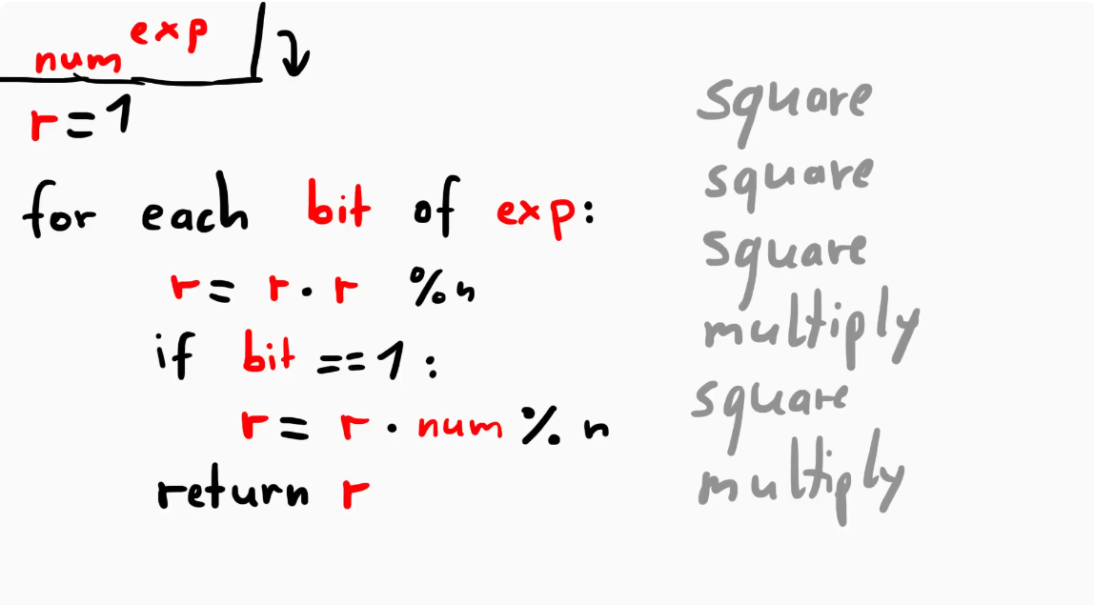
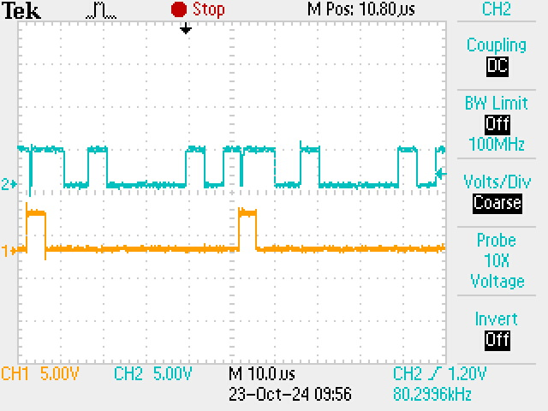
Project Overview
multiply
modulo
square
Notes:
As we know that encryption works by modulo exponentiation, we take the message to the power of the private key and modulo n it.
The picture on the left is the pseudocode for modulo exponentiation using the square and multiply algorithm.
The picture on the right shows the difference in the time taken when doing the different basic operations on Arduino.
-----------------------------------------------------------------------------------------------------------------------
Loop over each bit of the exponent, for every bit of the exponent, we square the intermediate value.
If the bit is a 1, we do an additional multiplication.
By doing so we will be able to figure out the bits of the exponent which is the private key.
The multiplier operation will have a different power consumption compared to the square operation.

Slide 5
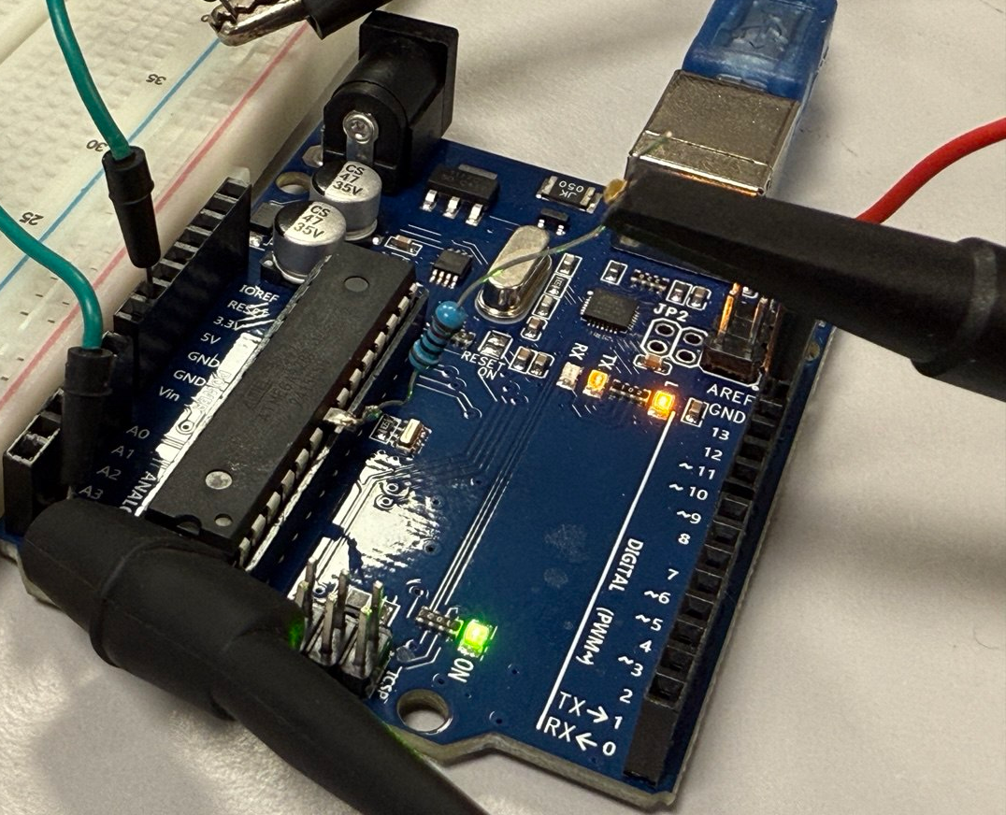
Simple Implementation of SPA (Arduino)
02
Ideally, ChipWhisperer would be the best option but it was too costly hence we found an alternative way which is to use Arduino instead
Notes:
Ideally, we were supposed to use a chipwhisperer to do this project and we tried asking the labs if they do have it but they don’t seem to have. So we found an alternative way which is to use Arduino instead.

Slide 6
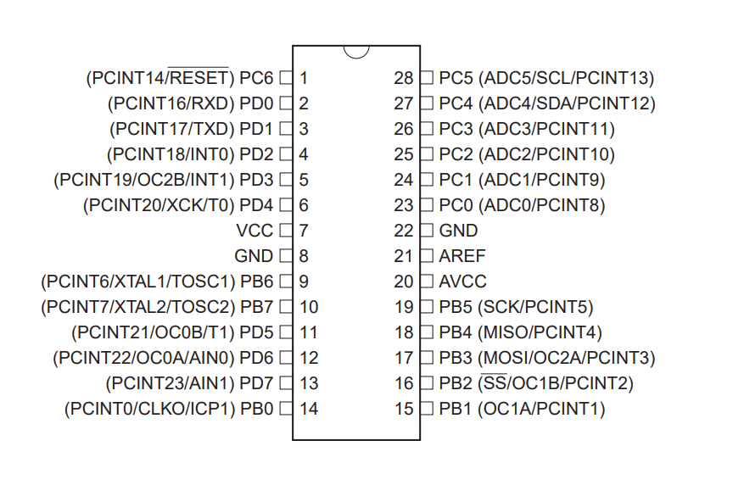
Simple Implementation of SPA (Arduino)
Notes:
After purchasing the Arduino boards, we referred to the datasheet to see which pin on the ic chip we should solder the resistor to. The purpose of the resistor is to allow us to measure the voltage drop across it which then tells us which modular exponentiation computing it is doing through the oscilloscope.
(bust out the dead arduinos)
------------------------------------------------------------------------------------------------------------------------------------------------------------------------------------------------------
We soldered the resistor to the leg of the IC chip so that we can measure the voltage drop across it and it allows us to know which modular exponentiation computing it is doing
Initially we tried to do it on the nano board which has surface mount ic chip but we were unable to desolder the pin properly

Slide 7
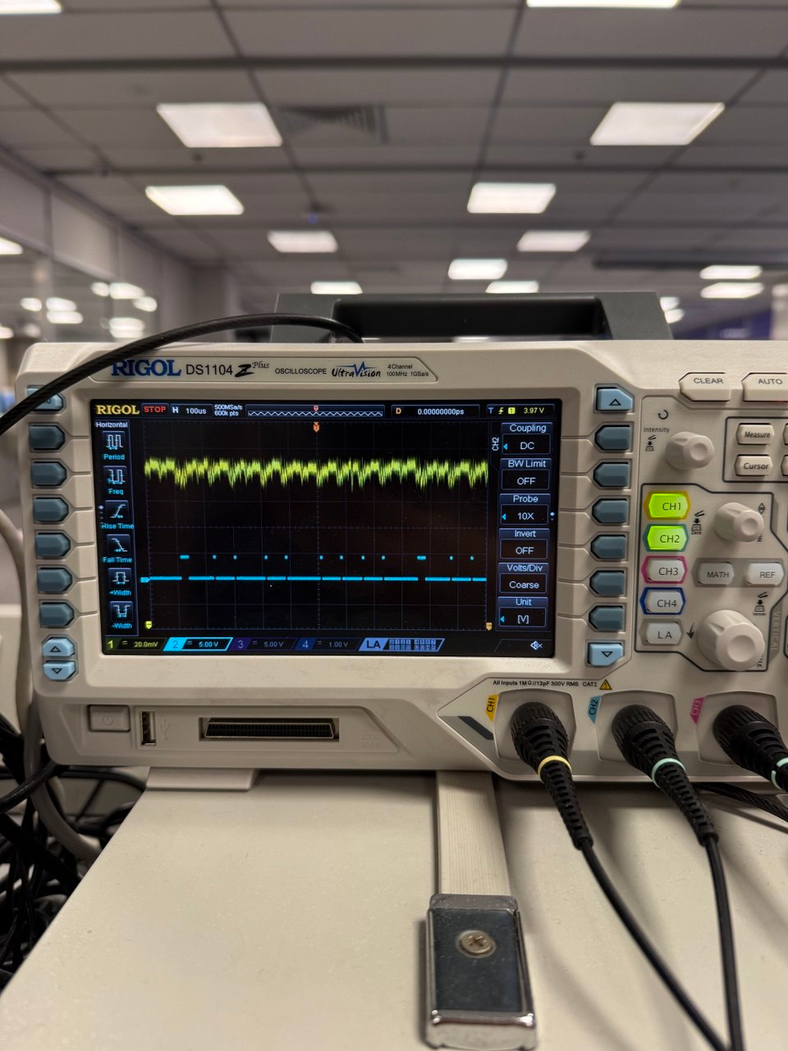
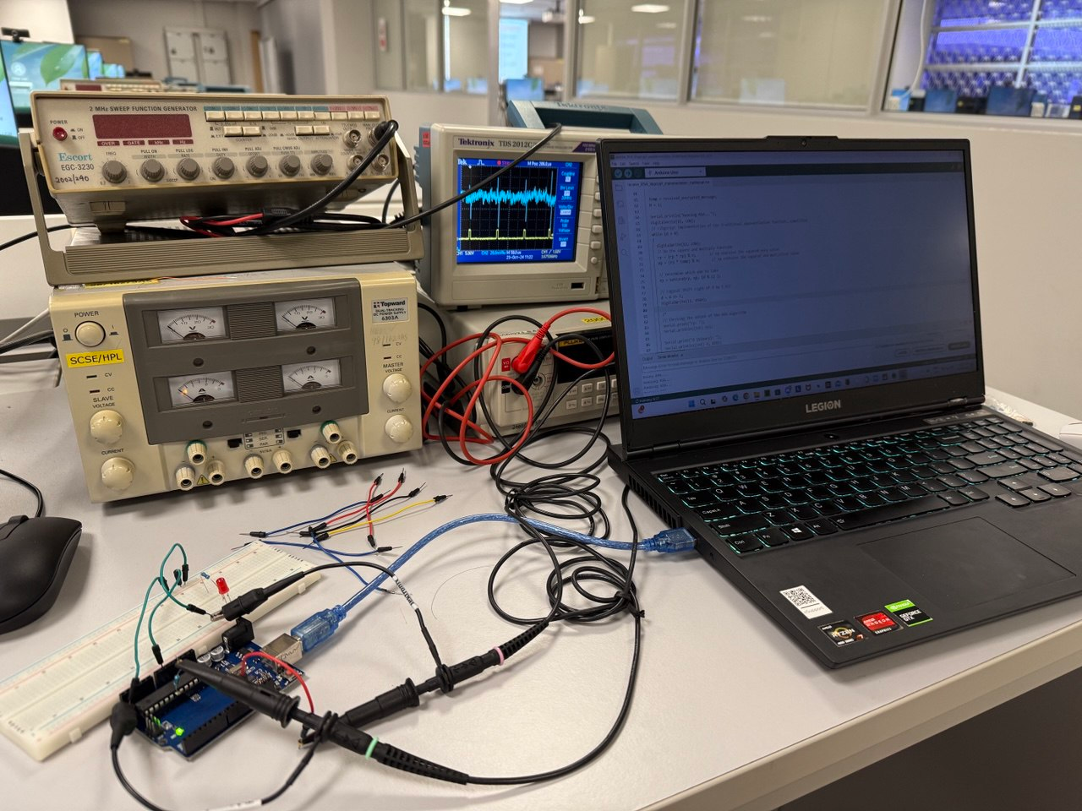
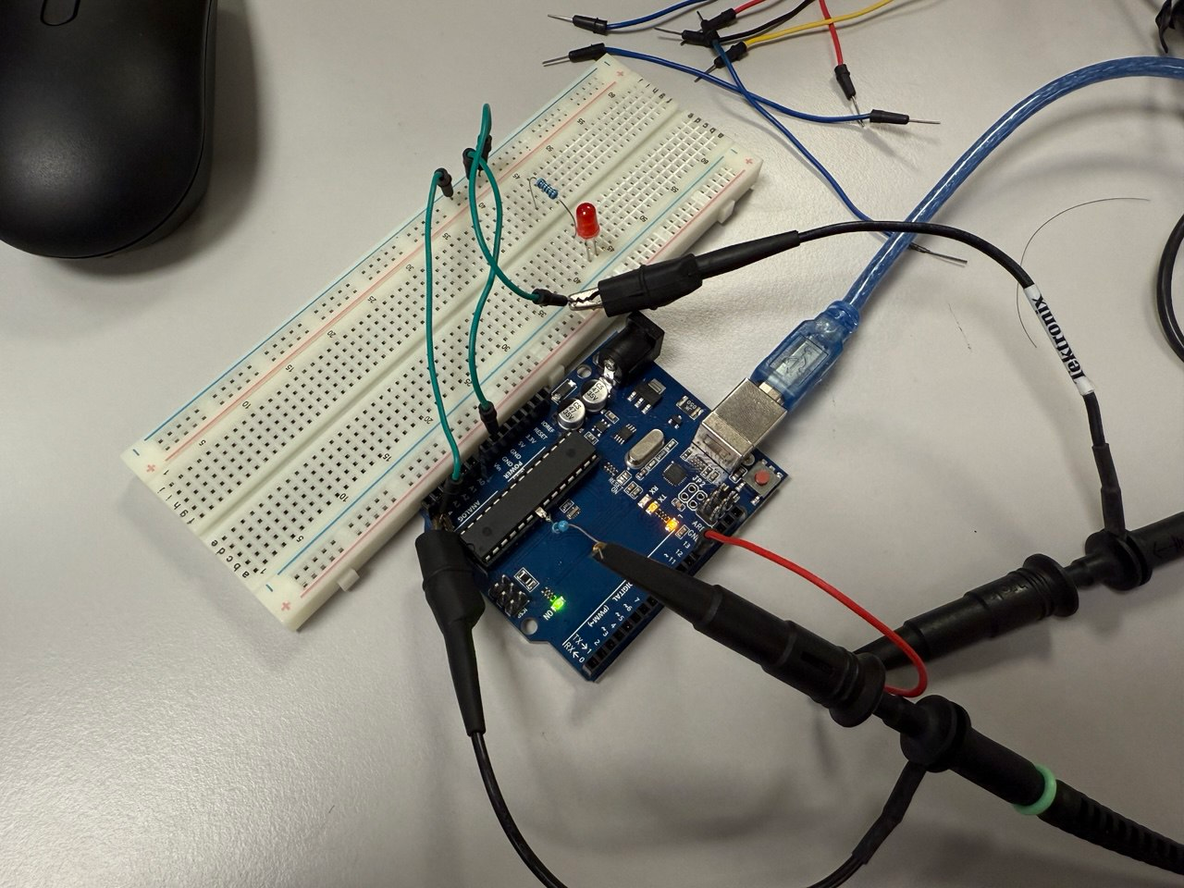
Simple Implementation of SPA (Arduino)
Notes:
Here are some picture of the set-up we did in the lab where we used the oscilloscope to get the reading of the power trace and had to tune the oscilloscope properly such that we can see the cycle properly.

Slide 8
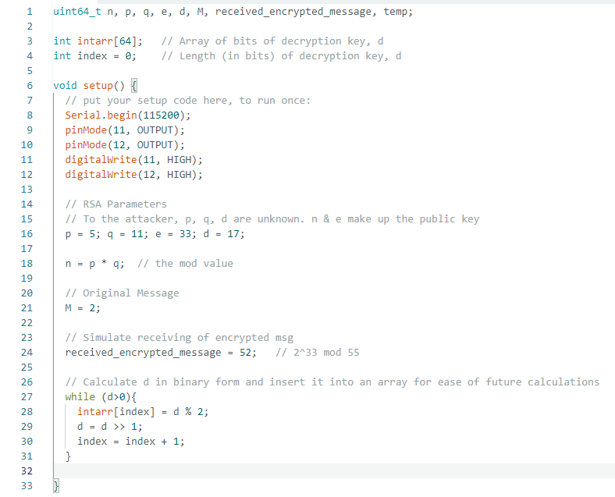
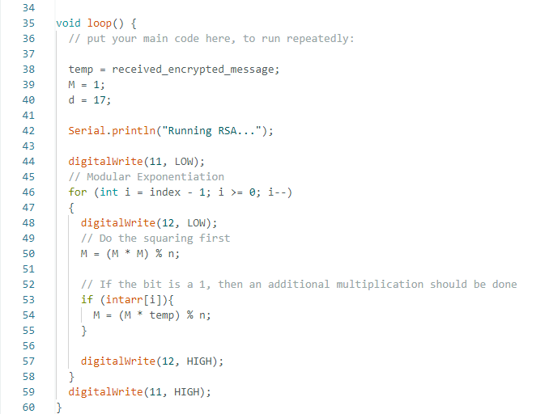
Simple Implementation of SPA (Arduino)
Notes:
This is the Arduino code we did. As we didn’t have another Arduino to act as the sender, we simulated the receiving of the encrypted message, and we did the code according to the pseudocode.

Slide 9
Code Explanation
03
-Moving over to Google Colab-
Notes:
Now we will be showing the code of the project and how we plot out the values we got from the oscilloscope.
------------------------------
Up till here about 2mins

Slide 10
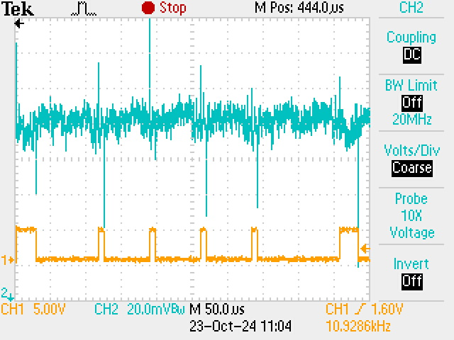
Segmenting the Power Trace
Notes:
However, the research paper did manage to find an exploit.
After locating each Region of Interest, the segments that represent one bit, they then overlay the Regions of Interests together

Slide 11
Segmenting the Power Trace
arr[4]
arr[3]
arr[2]
arr[1]
arr[0]
Notes:
However, the research paper did manage to find an exploit.
After locating each Region of Interest, the segments that represent one bit, they then overlay the Regions of Interests together

Slide 12
Segmenting the Power Trace
1
0
0
0
1
arr[4]
arr[3]
arr[2]
arr[1]
arr[0]
Notes:
However, the research paper did manage to find an exploit.
After locating each Region of Interest, the segments that represent one bit, they then overlay the Regions of Interests together

Slide 13
Review of Libgcrypt RSA Implementation
04
Blind-Folded: Simple Power Analysis Attacks using Data with a Single Trace and no Training
Notes:
Something else that we would like to add would be a quick review of Libgcrypt's RSA Implementation and how it was vulnerable to SPA.

Slide 14
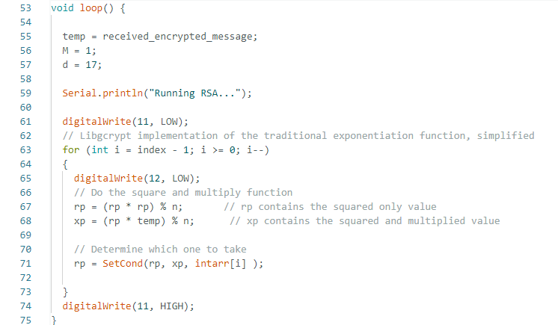
Libgcrypt RSA(traditional) Implementation
Notes:
For Libgcrypt's implementation of the traditional RSA implementation, it uses a masking technique.
Regardless of bit value, it will always do square and multiplication, storing results of squaring only and square & multiply.

Slide 15
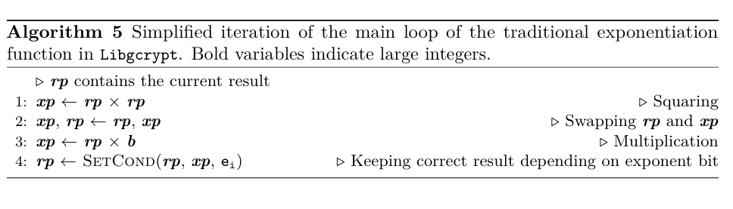
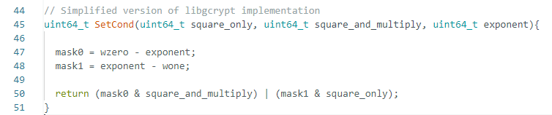
Libgcrypt RSA(traditional) Implementation
Notes:
It then calls a function which will determine which value to take

Slide 16
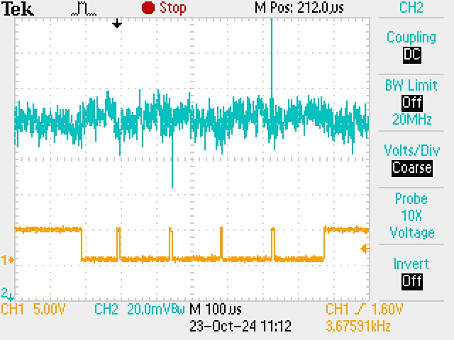
Libgcrypt RSA(traditional) Implementation
Notes:
This resolves the timing issue and causes the segments to all be of roughly equal lengths.

Slide 17
Manually find a few ROI. Overlay them
ROI - Region Of Interest
Segment of the Trace that correspond to one bit
Notes:
However, the research paper did manage to find an exploit.
After locating each Region of Interest, the segments that represent one bit, they then overlay the Regions of Interests together

Slide 18
Libgcrypt RSA(traditional) - Locating ROI
Determine a threshold value: Maximum tolerable variance between each point for each segment
Needs to be larger than max difference observed
Use one ROI with threshold values to identify other ROI in the power trace

Slide 19
Libgcrypt RSA(traditional) - Locating POI
-Back over to Google Colab-

Slide 20
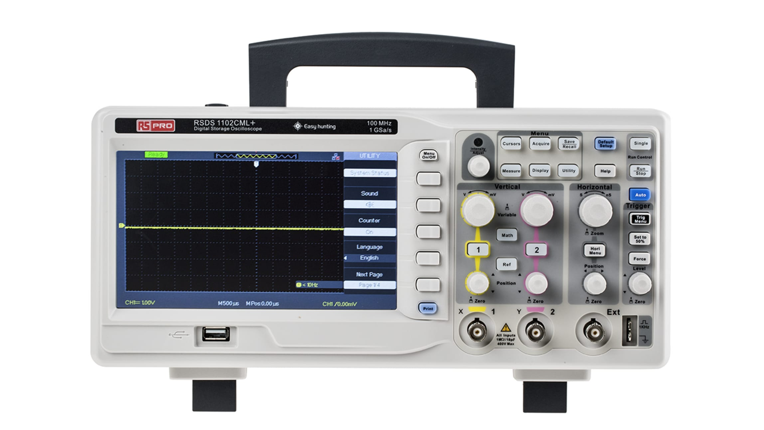
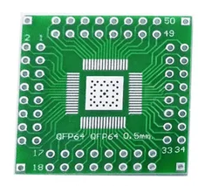
Limitation/improvement for future
Isolate chip
Hardware Limitations
RSA (Windowed) & ECDSA
Capacitors and noise influence the power trace
Oscilloscope Accuracy
Other attacks using SPA covered in the paper.
Notes:
With regards to the limitations,
On the circuit board there are things like capacitors which will influence the power trace like the charging and discharging of it.
When the traces gets longer, we need to increase the timescale to fit the power trace onto the display of the oscilloscope. However, increasing the timescale will reduce the accuracy of the power trace.
Thus, the dips in the voltage can sometimes not be as obvious as the others.
------------------------------------------------------------------------------------------------------------------------------------------------------------------------------------------------------------------
As traces get longer, we would need to increase the timescale to fit the power trace onto the display of the oscilloscope.
However, if we increase the timescale, it reduces the accuracy of the power trace. Thus, dips in voltage can sometimes not be as pronounced, leading to traces like these (show the big d)

Slide 21
Thanks!
Do you have any questions?

